Slide 1
DRUG CLASSIFICATIONS

Slide 2
Let’s see how much you know
http://teens.drugabuse.gov/quiz/national-drug-facts-week/take-iq-challenge/2015

Slide 3
Drug Use, Misuse, and Abuse
Use- Taking a drug correctly for a legitimate medical reason. (taking vicodin prescribed by a doctor for pain after surgery, having a soda or coffee would fit here also)
Misuse- Using a legal drug for purposes it is not intended for but will help them feel better (not following instructions-taking more than you should, taking someone’s non-scheduled prescription drug)
Abuse- Taking an illegal drug with no prescription to experience the feelings associated with the drug: high, intoxication, etc. (drinking alcohol if under age, shooting heroin at a party, taking someone else’s scheduled prescription drug)

Slide 4
Physical Vs. Psychological Addiction
Physical | Psychological
Sweating | Anxiety
Heart Palpitations | Restlessness
Muscle tension | Irritability
Difficult breathing | Insomnia
Tremors or uncontrollable shaking | Depression
Seizures | Paranoia
Nausea | Hallucinations

Slide 5
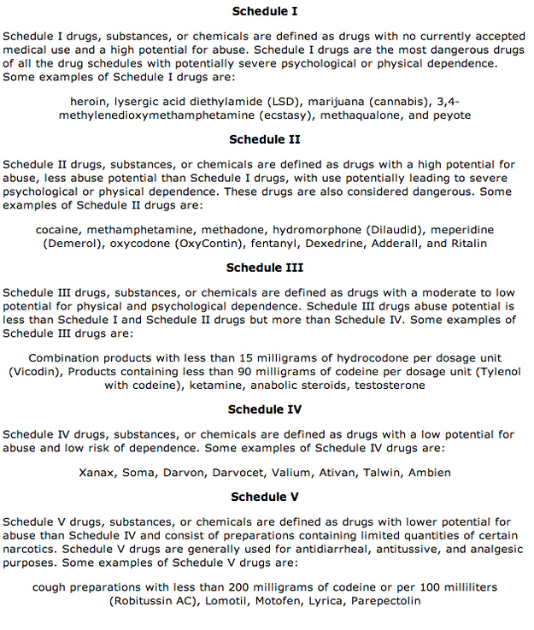
Drug Schedule

Slide 6
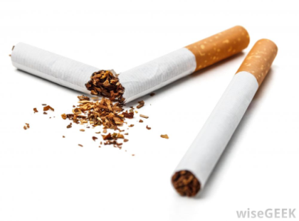

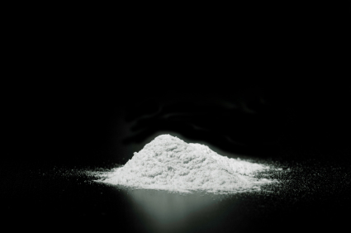
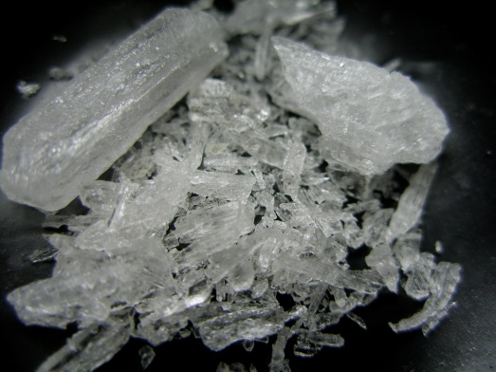
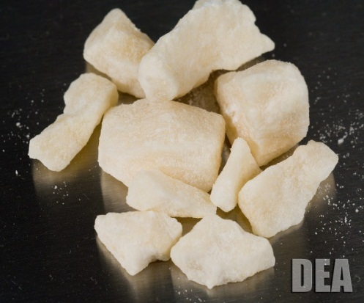
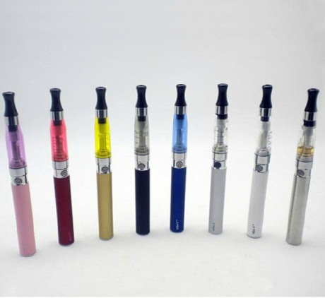
STIMULANTS
Stimulate the Central Nervous System (CNS).
  Temporarily increase alertness and energy
Examples: Caffeine (coffee, soda, energy drinks, etc.), Nicotine (tobacco, e-cigs), Methamphetamines, and Crack (cheaper)/Cocaine
ALL addictive

Slide 7
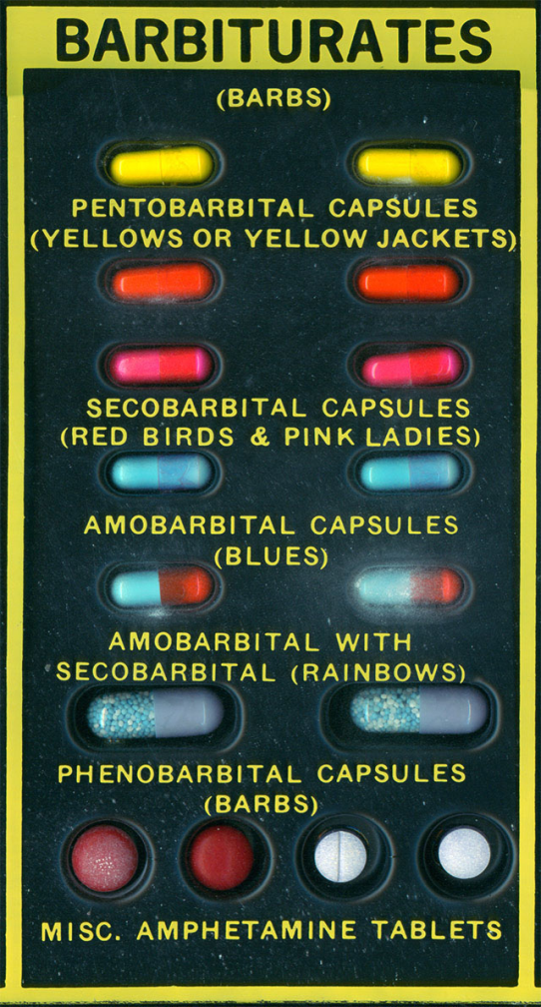
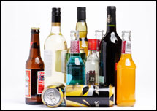
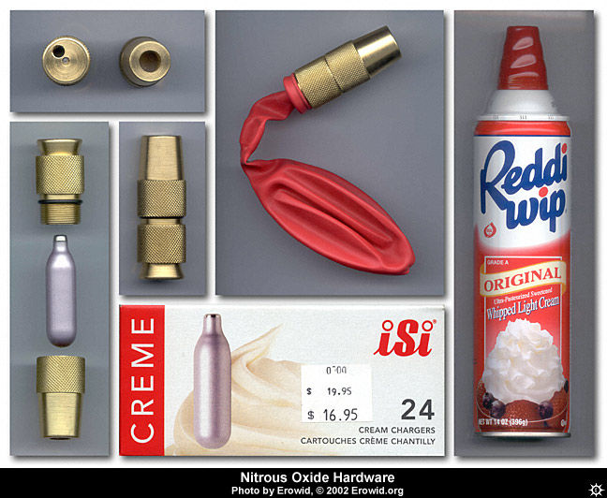
Depressants
Drugs that slow down the CNS.
Examples: Barbiturates (sleeping pills), alcohol(most commonly used drug), anesthetics (nitrous oxide)

Slide 8
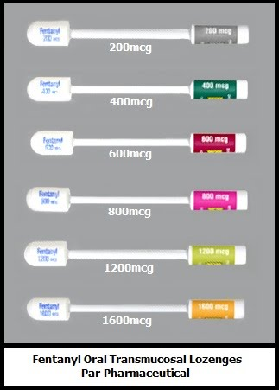
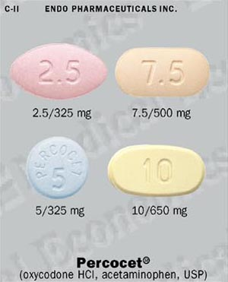
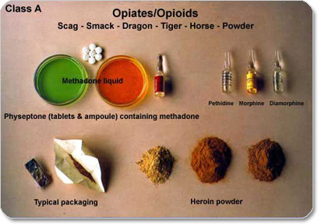
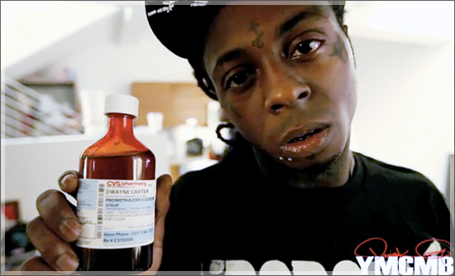
NARCOTICS/OPIODS
Examples: Heroin, Opium, Codeine, Percocet, Morphine, Fentanyl ( a painkiller 100 times stronger than morphine), & many more.
  Illegal if sold/used for non-medical purposes
    Most relieve pain
    Can slow breathing, cause sedation & instant addiction

Slide 9
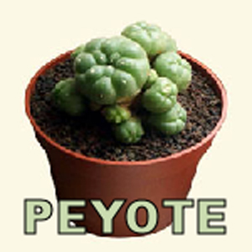
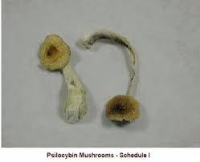
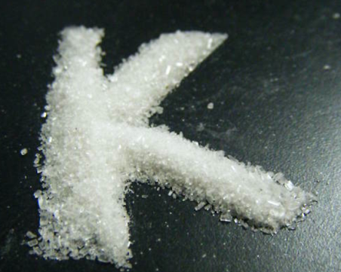
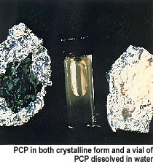
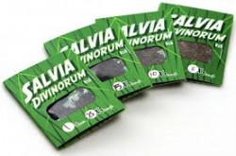
HALLUCINOGENS
Affects a person’s perceptions, sensations, thinking and emotions.
Examples: Mushrooms- “shrooms” (psilocybin & psilocyn), Peyote, Ketamine, Salvia, and PCP

Slide 10
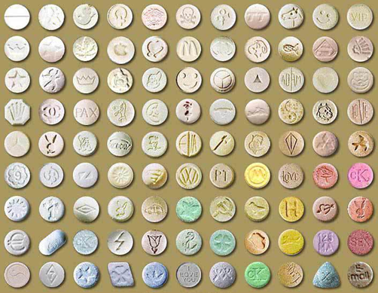
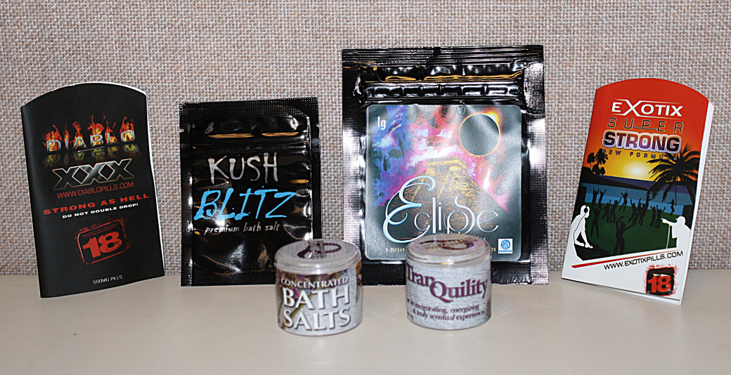
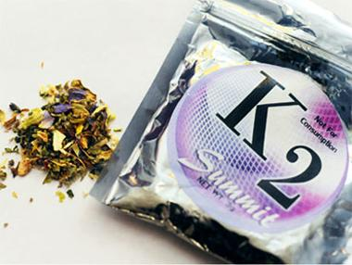
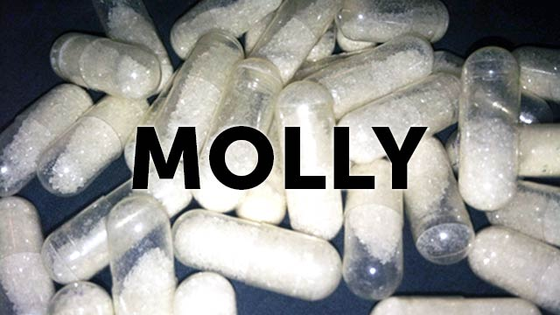
Synthetic/Hallucinogenic Drugs
Examples: LSD (acid), Bath Salts, MDMA (ecstasy), Molly (pure crystalline power form of MDMA) and synthetic cannabinoids (k2 or spice)
“products are not intended for human consumption”

Slide 11
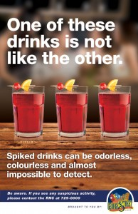
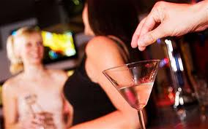
“Date Rape” Drugs
What are some preventative steps against these drugs?
Rohypnol, GHB, and Ketamine –
Commonly used to assist a sexual assault or victimization (robbery or physical assault) of someone without their consent
Street Name: Roofies, “Georgia Home Boy” GHB , and Special K

Slide 12
OTC & Prescription Drugs
One pill, one felony
“Over the Counter” Drugs
Prescription Drugs
Medicine without the need for a prescription
  ID swipes for some medicines containing pseudoephedrine
Examples:10-over-the-counter-medicines-abused-by-teens
Risks: mixing meds can be dangerous, liver and kidney damage
Need a doctor to prescribe
Depressants: Valium, Xanax
Stimulants: Ritalin and Adderall
Pain Killers: OxyContin, Vicodin, Perocet
Do you think you should drive while using these medicines?

Slide 13
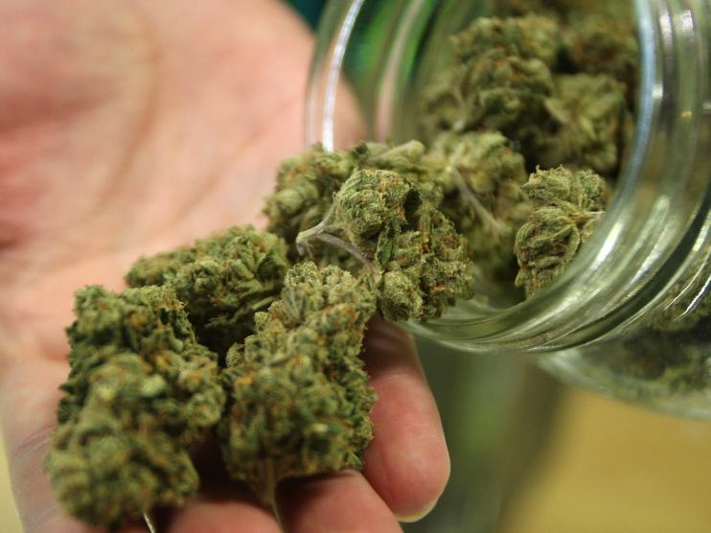
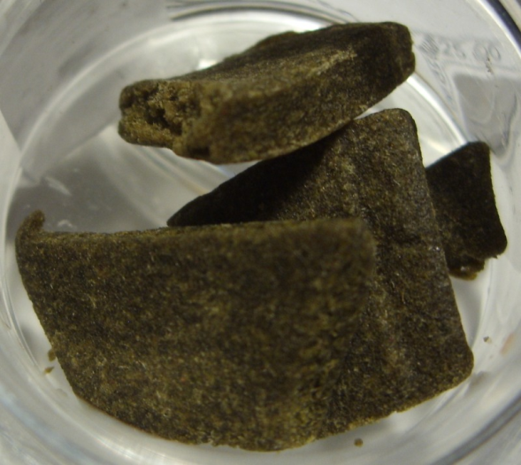
Marijuana/Hashish
Which one contains the higher consideration of THC?
Contains THC- the psychoactive ingredient
Each form contains various amounts of THC; which affects the strength of the drug.
Danger = It can be laced with other drugs (prescription drugs, cocaine, etc.)
Can remain in the bloodstream up to 45 days.
Both Physically & Psychologically addicting; shaking, irritability, insomnia, anxiety

Slide 14

Additional Drug Info.
With someone close to you, talk through the following questions.
What are considered “gateway drugs”?
What is addiction?
What is tolerance?
What is withdrawal?
What are refusal skills?
What are the benefits of staying free of drugs and alcohol?
EggTimer

Slide 15
“The greatest danger of drugs is that they destroy the most important thing in life-
the power to decide.”
  The most precious and valuable thing you have is your power to choose.

